Slide 1
Parameter design for investigating the effect of group behaviour on crowd dynamics
Summary the key parameter affecting group behaviour
Parameter Design
2.1. Hypotheses from the theoretical model
2.2. Group effect measurement algorithm
Notes:
The effect of group behaviour on crowd dynamics.-> to extract useful information (interaction between group) for evacuation plan (should escape group or alone, group by group) according to parameters of each group;
In various design layout- , flow rate average, flow rate of each group.
Discussion about which design layouts suitable, plans suit for group having maximum group cohesion, or group speed., guidance for evacuation plan
-----------------------------------------------------------------------------------------------------------------------------------------------------------------------------------------------------------------
What is data in panic situations useful for human crowd modelling? Hard because data in panic is rare, not fix. Previous studies almost investigate general data for context detection at dense place; or data in normal situation; or machine learning for abnormal behaviour detection model when disaster already happened- not for panic situations. While panic situations- group of pedestrians escape together rather escape alone), with learder or group of different ped parameter distribution. This study focuses on the instinct characteristic of group behaviour in simulations when they interact in order to extract useful information before disasters happen.
Discussion about which design layouts suitable, plans suit for maximizing group cohesion, or group speed. – Group contains pedestrians having different parameter to those of others.
The data of extracting interaction between groups in which groups have different parameters to those of others (group have maximize group cohesion, group have low speed) .
Guidance for each group evacuation; adding stochastic information dynamic context

Slide 2
Group cohesion degree
Correlation testing
Sobol indices analysis
Verification
Notes:
Anti group,
Correlation testing,
the overall effects of one parameter on the variance of model’s output
Tuning verify parameter, keep the same scenario
At base parameter

Slide 3
Group average speed
Correlation testing
Sobol indices analysis
Verification
Notes:
Correlation testing,
Anti group,
Tuning verify parameter

Slide 4
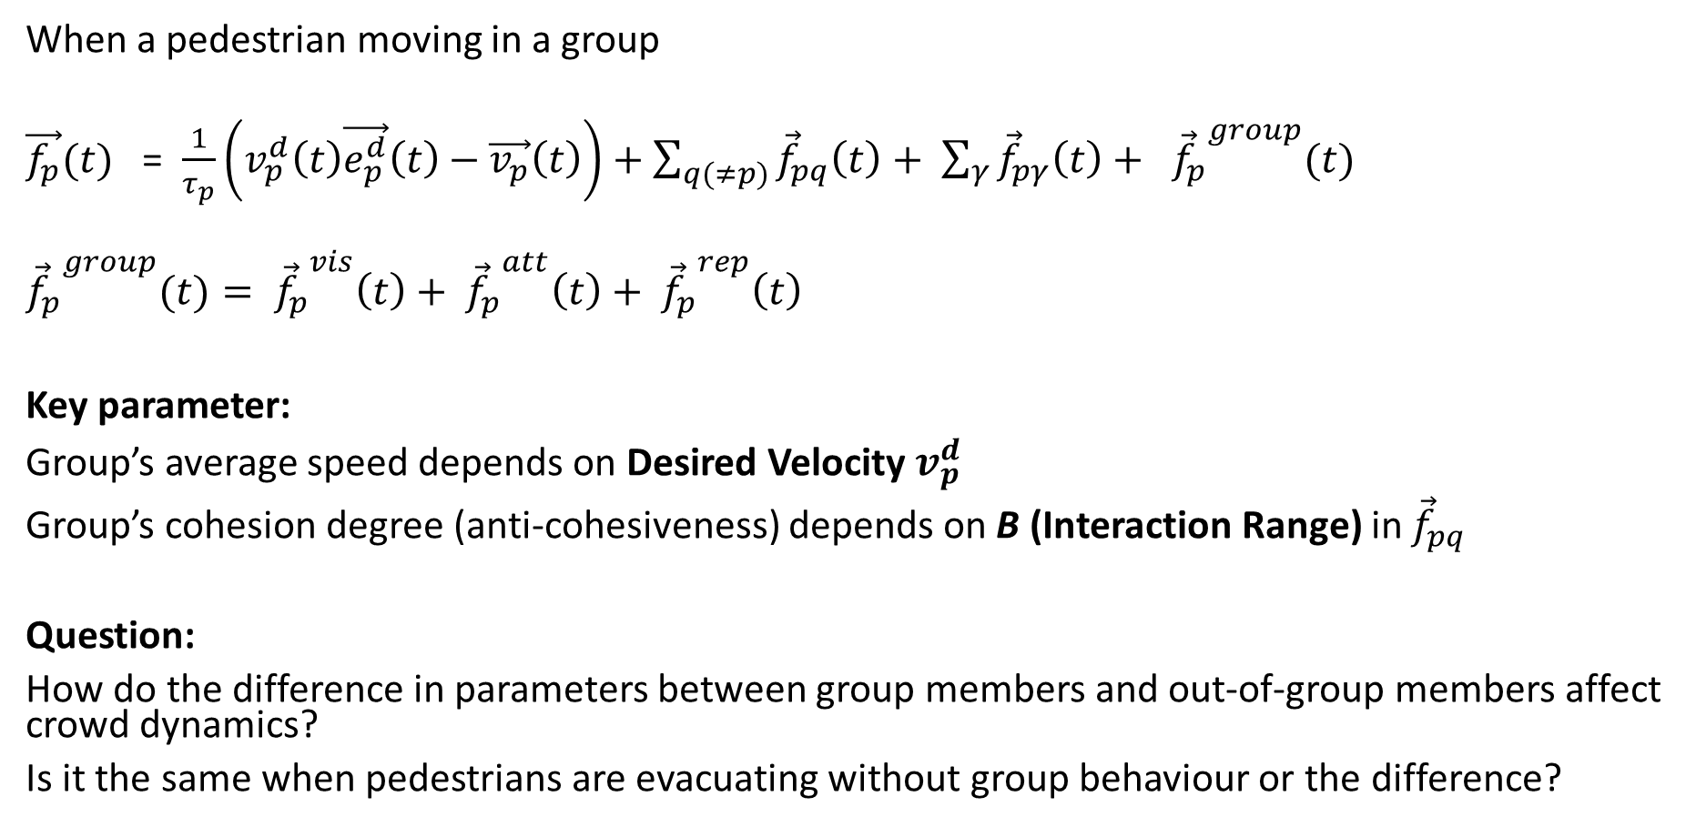
2.1. Parameter Design-Review from theoretical force model
When a pedestrian moving in a group
$\vec{f_{p}}(t)$ = $\frac{1}{τ_{p}}\left(v_{p}^{d}\left(t\right)\vec{e_{p}^{d}}\left(t\right)−\vec{v_{p}}\left(t\right)\right)+\sum_{q(≠p)}{{\vec{f}}_{pq}\left(t\right)+ \sum_{γ}{{\vec{f}}_{pγ}\left(t\right)+ {{\vec{f}}_{p}}^{group}(t)}}$
$${{\vec{f}}_{p}}^{group}(t)= {{\vec{f}}_{p}}^{vis}\left(t\right)+ {{\vec{f}}_{p}}^{att}\left(t\right)+ {{\vec{f}}_{p}}^{rep}\left(t\right)$$
Key parameter:
Group’s average speed depends on Desired Velocity $v_{p}^{d}$
Group’s cohesion degree (anti-cohesiveness) depends on B (Interaction Range) in ${\vec{f}}_{pq}$
Question:
How do the difference in parameters between group members and out-of-group members affect crowd dynamics?
Is it the same when pedestrians are evacuating without group behaviour or the difference?
Notes:
The first three force depends on the information of each group members
The last group force is condition force depends on environment, (placements)
The higher interaction range , you feel more uncomfortable and repulsive force between you and other pedestrians increases
modelling the difference with the outputs-
Whether the effect is the same as pedestrians moving individual without group, or
Understanding this information is important: since it give hints to help us know in evacuation should we evacuation by group or individual, modelling the effect of this difference with model’s output (flow rates)?
hypothesises on each element force on crowd to understand the difference between individuals, or same as other group on crowd dynamics (flow rates, flow rate each group)
Other observation data

Slide 5
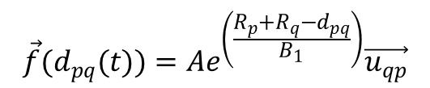

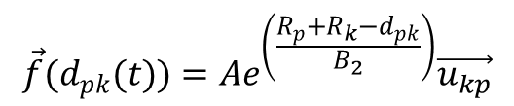
2.1. Parameter design- hypothesises regarding repulsive force
Hypothesises: Pedestrians in same group have less repulsive forces than the same force caused by out-of-group members
(H1) Group of pedestrians have
lower Interaction Range (B) for in-group members
higher Interaction Range (B) for out-of-group members
(H2) Group of pedestrians have
lower Interaction Strength (A) for in-group members
higher Interaction Strength (A) for out-of-group members
$$\vec{f}(d_{pq}(t))=Ae^{\left(\frac{R_{p}+R_{q}−d_{pq}}{B_{1}}\right)}\vec{u_{qp}}$$
$$\vec{f}(d_{pk}(t))=Ae^{\left(\frac{R_{p}+R_{k}−d_{pk}}{B_{2}}\right)}\vec{u_{kp}}$$
$$B_{1}=\frac{1}{k}B_{2}$$
Notes:
Hoorgedoorn found that, children <elderly< adults
(easily accept other pedestrians standing closer)

Slide 6
2.1. Parameter design- hypothesises regarding cohesiveness constraint
(H3)Whether two groups of pedestrians having different attraction range to group centre give the difference in crowd dynamics
(H4) Whether two groups of pedestrians having different vision force to see their group centre give the difference in crowd dynamics

Slide 7
2.1. Parameter Design for the hypothesis regarding group speed
(H5)Hypothesis about the difference in the desired speed of two groups

Slide 8
2.2. Group effect measurement algorithm
Step1: Define design layouts and group’s context
Step2: Define parameters according to hypothesis
Step3: Observation analysis
Measure flow rates of groups
Measure overall flow rate
Measure environment information(crowd density, crowd pressure at different cells on the layouts)
Compare the above results to those values in scenarios without group behaviour or the difference between in-of-group and out-of-group members
Step4: Modelling the difference with the change of each observation in step 3
Notes:
Contain different layouts, placements of group, number of pedestrians
Propose hypothesises measurement by turning parameters
Observation: return data (crowd density-heatmap, flow rates, crowd pressure)
Analysis and verification

